Slide 1

COMPUTER NETWORKS
S Nagasundari
Department of Computer Science and Engineering

Slide 2

COMPUTER NETWORKS
Unit – 5 Link Layer and LAN Roadmap
Introduction
Error detection, correction
Multiple access protocols
LANs
Addressing, ARP
Ethernet
Switches
A day in the life of a web request
Physical layer
Wireless LANs: IEEE 802.11

Slide 3
COMPUTER NETWORKS
Class 51 : Link Layer Switches : Learning Objectives
Multiple Simultaneous Transmissions
Frame Forwarding and Filtering

Slide 4
COMPUTER NETWORKS
Ethernet switch
Switch is a link-layer device: takes an active role
Store, forward Ethernet frames
Examine incoming frame’s MAC address,
selectively forward frame to one-or-more outgoing links,
uses CSMA/CD to access segment
Transparent: hosts unaware of presence of switches
Plug-and-play, self-learning
Switches do not need to be configured

Slide 5


COMPUTER NETWORKS
Switch : Multiple Simultaneous Transmissions
Hosts have dedicated, direct connection to switch
Switches buffer packets
Ethernet protocol used on each incoming link, so:
no collisions; full duplex
each link is its own collision domain
A
C’
B
1
2
6
3
5
4
B’
C
A’
Switching: A-to-A’ and B-to-B’ can transmit simultaneously, without collisions
switch with six interfaces (1,2,3,4,5,6)

Slide 6

COMPUTER NETWORKS
Switch : Multiple Simultaneous Transmissions
Hosts have dedicated, direct connection to switch
Switches buffer packets
Ethernet protocol used on each incoming link, so:
No collisions; full duplex
Each link is its own collision domain
A
C’
B
1
2
6
3
5
4
B’
C
A’
Switching: A-to-A’ and B-to-B’ can transmit simultaneously, without collisions
but A-to-A’ and C to A’ can not happen simultaneously
switch with six interfaces (1,2,3,4,5,6)

Slide 7
COMPUTER NETWORKS
Switch Forwarding Table
Q: How does switch know A’ reachable via interface 4, B’ reachable via interface 5?
A
C’
B
A: Each switch has a switch table, each entry:
(MAC address of host, interface to reach host, time stamp)
looks like a routing table!
1
2
6
3
5
4
B’
C
A’
Q: How are entries created, maintained in switch table?
something like a routing protocol?

Slide 8
COMPUTER NETWORKS
Switch : Self - learning
Source: A
Dest: A’
Switch learns which hosts can be reached through which interfaces
A A’
A
C’
B
When frame received, switch “learns” location of sender: incoming LAN segment
1
2
6
3
5
4
Records sender/location pair in switch table
B’
C
A’
Switch table
(initially empty)
MAC addr interface TTL
A
1
60

Slide 9
COMPUTER NETWORKS
Switch : Frame Filtering / Forwarding
When frame received at switch:
1. Record incoming link, MAC address of sending host
2. Index switch table using MAC destination address
3. If entry found for destination then {
If destination on segment from which frame arrived then drop frame
else forward frame on interface indicated by entry
}
else flood /* forward on all interfaces except arriving interface */

Slide 10
COMPUTER NETWORKS
Self-learning, Forwarding : Example
Source: A
Dest: A’
Frame destination, A’, location unknown:
A A’
Flood
A
C’
B
Destination A location known:
Selectively send
on just one link
1
2
6
A A’
A A’
A A’
A A’
A A’
3
5
4
B’
C
switch table
(initially empty)
A’ A
A’
MAC addr interface TTL
A
1
60
A’
4
60

Slide 11


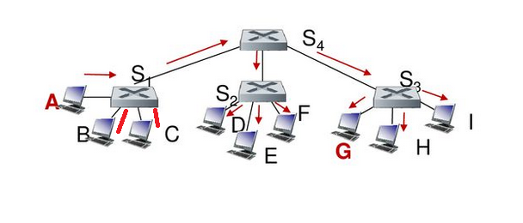
COMPUTER NETWORKS
Interconnecting Switches
Self-learning switches can be connected together:
Q:
Sending from A to G –
how does S₁ know to forward frame destined to G via S₄ and S₃?
S₄
S₁
S₃
A
S₂
F
I
B
C
D
E
G
H
A: self learning! (works exactly the same as in single-switch case!)

Slide 12
COMPUTER NETWORKS
Self-learning Multi-switch Example
Suppose C sends frame to I, I responds to C
S₄
S₁
S₃
A
S₂
F
I
B
C
D
E
G
H
Q: show switch tables and packet forwarding in S₁, S₂, S₃, S₄

Slide 13
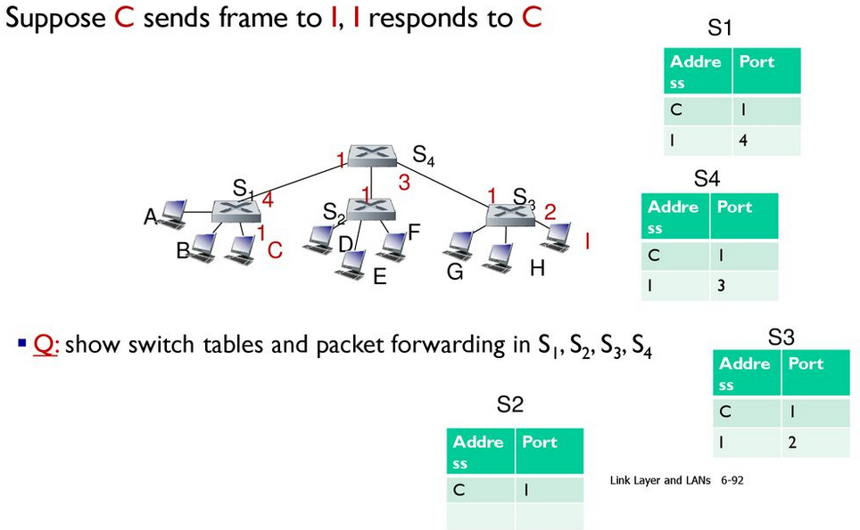
COMPUTER NETWORKS
Self-learning Multi-switch Example

Slide 14
COMPUTER NETWORKS
Properties of Link Layer Switching
Elimination of collisions
In a LAN built from switches (and without hubs), there is no wasted bandwidth due to collisions!
buffer frames and never transmit more than one frame on a segment at any one time.
As with a router, the maximum aggregate throughput of a switch is the sum of all the switch interface rates.
provide a significant performance improvement over LANs with broadcast links.
Heterogeneous links
Because a switch isolates one link from another, the different links in the LAN can operate at different speeds and can run over different media.
Example, three1 Gbps 1000BASE-T copper links, two 100 Mbps 100BASE-FX fiber links, and one 100BASE-T copper link.

Slide 15
COMPUTER NETWORKS
Properties of Link Layer Switching
Management
providing enhanced security,
eases network management
Example,
If an adapter malfunctions and continually sends Ethernet frames (called a jabbering adapter),
a switch can detect the problem and internally disconnect the malfunctioning adapter.
Similarly, a cable cut disconnects only that host that was using the cut cable to connect to the switch.
Gather statistics on bandwidth usage, collision rates, and traffic types, and make this information available to the network manager.
Used to debug and correct problems, and to plan future LAN

Slide 16
COMPUTER NETWORKS
Small Institutional Network
mail server
to external
network
router
web server
IP subnet

Slide 17
COMPUTER NETWORKS
Switches Vs Routers
application
transport
network
link
physical
Both are store-and-forward:
Routers: network-layer devices (examine network-layer headers)
Switches: link-layer devices (examine link-layer headers)
datagram
frame
link
physical
frame
switch
Both have forwarding tables:
Routers: compute tables using routing algorithms, IP addresses
Switches: learn forwarding table using flooding, learning, MAC addresses
network
link
physical
datagram
frame
application
transport
network
link
physical
6-17

Slide 18
COMPUTER NETWORKS
Switches Vs Routers
Switches
Pros
plug-and-play
relatively high filtering and forwarding rates
prevent the cycling of broadcast frames, the active topology of a switched network is restricted to a spanning tree.
Cons
large switched network would require large ARP tables in the hosts and routers and generate substantial ARP traffic and processing.
susceptible to broadcast storms
if one host goes haywire and transmits an endless stream of Ethernet broadcast frames, the switches will forward all of these frames, causing the entire network to collapse

Slide 19
COMPUTER NETWORKS
Switches Vs Routers
Routers
Pros
Because network addressing is hierarchical, packets do not normally cycle through routers even when the network has redundant paths.
packets can cycle when router tables are misconfigured;
IP uses a special datagram header field to limit the cycling.
packets are not restricted to a spanning tree and can use the best path between source and destination.
allowed the Internet to be built with a rich topology. Ex: multiple active links between Europe and North America.
provide firewall protection against layer-2 broadcast storms.
Cons
not plug-and-play—they and the hosts that connect to them need their IP addresses to be configured.
Larger per-packet processing time than switches

Slide 20
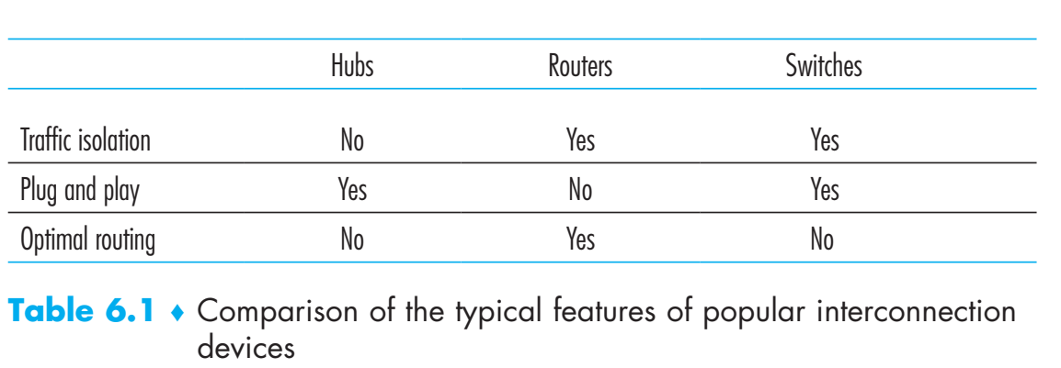
COMPUTER NETWORKS
Hubs Vs Switches Vs Routers

Slide 21
THANK YOU
S Nagasundari
Department of Computer Science and Engineering
nagasundaris@pes.edu

